Slide 1

Plant Disease Classification

Slide 2
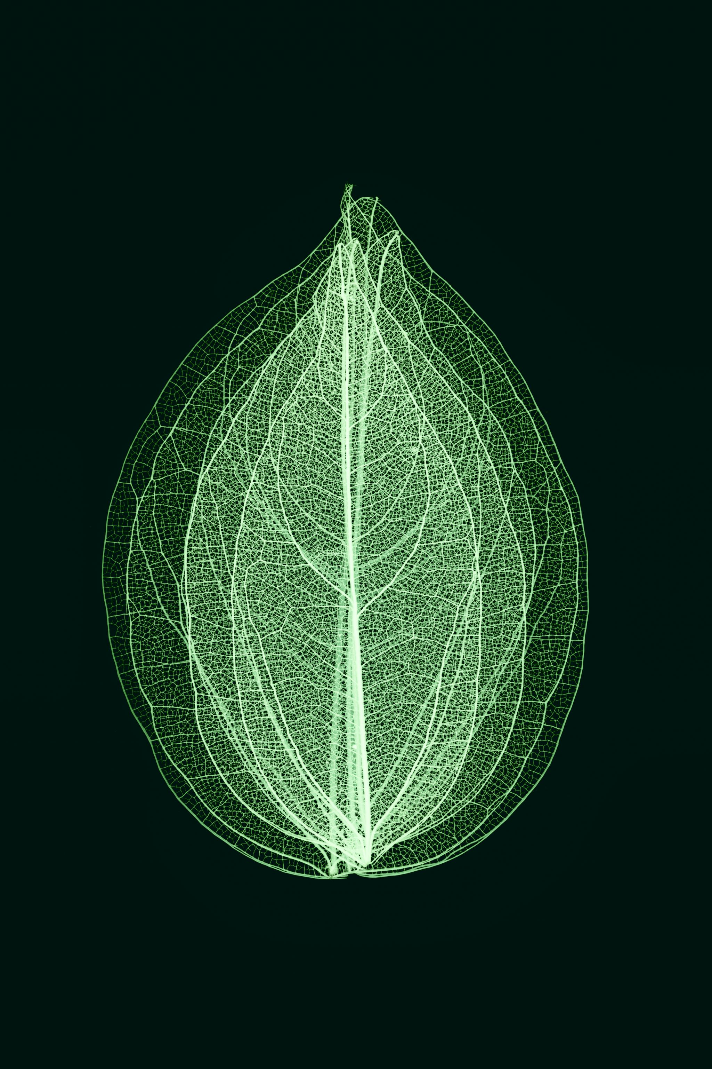
Objective
The goal is to employ deep learning techniques for detecting diseases in cotton leaves through a binary classification approach, distinguishing between diseased and healthy leaves.

Slide 3
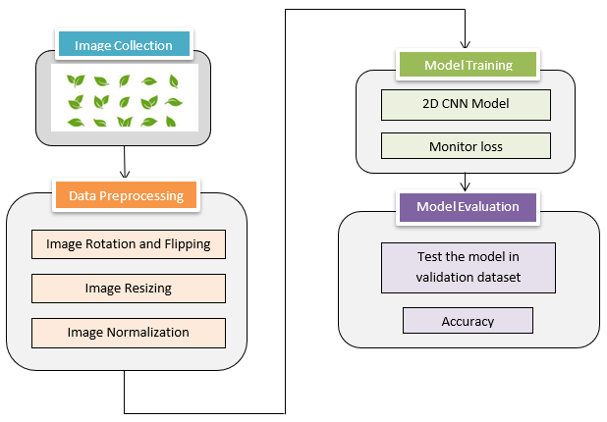
Methodology - Pipeline

Slide 4

Step 1: Data collection
Collected from kaggle : https://www.kaggle.com/datasets/janmejaybhoi/cotton-disease-dataset/data

Slide 5
Step 1: Dataset Loading
Creation of DataLoaders is a key step in preparing data for machine learning. These DataLoaders enable efficient and batch-wise processing of data, ensuring that your model is trained and evaluated effectively.
It's configured with a batch size of 2, meaning that during training, the dataset is divided into batches, each containing two samples. This allows for processing multiple data points in parallel, which can significantly speed up training, especially when using GPUs.

Slide 6
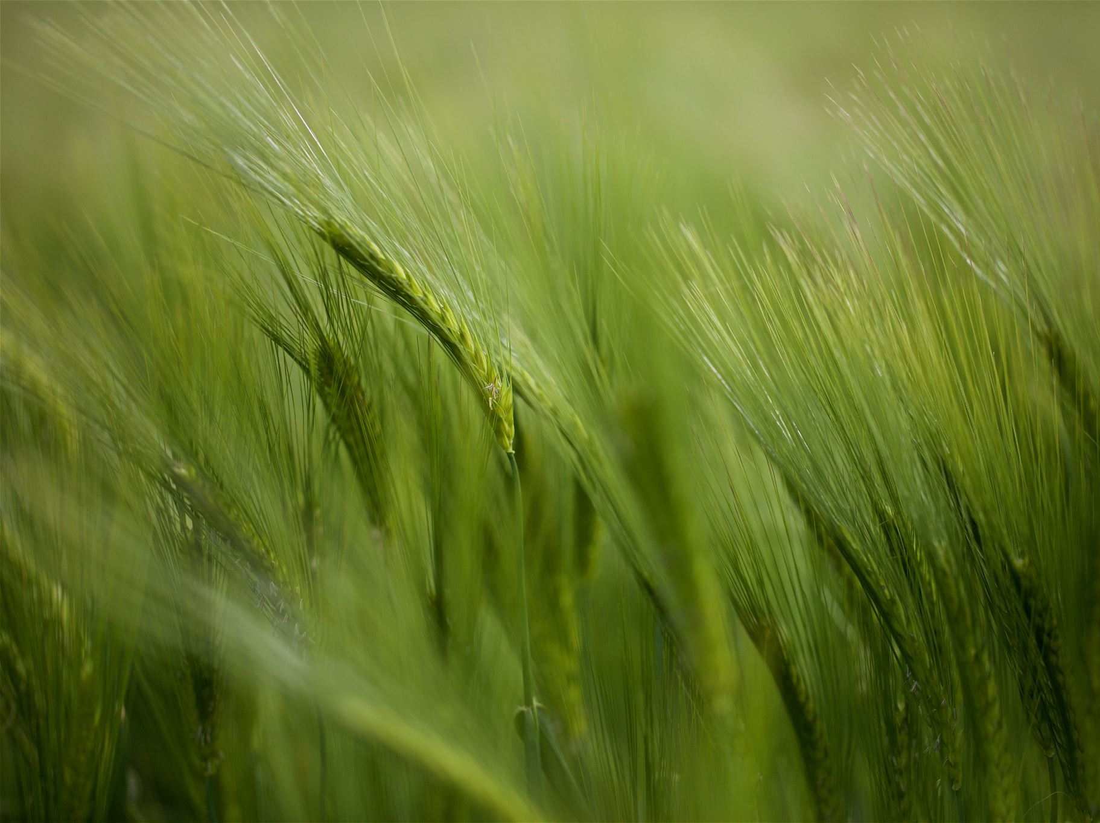
Step 2: Data Preprocessing
Perform image resize, image flipping, image rotation, image normalization
Image flipping: It randomly flips the image horizontally or vertically.
Image rotation: It randomly rotates the image by up to specified degrees.
Image resize: It randomly crops and resizes the image.
Normalization: It normalizes the image pixel values with specified mean and standard deviation.

Slide 7

Step 3 : Model Building
The SimpleCNN model provided in the code is a four-layer model. It consists of the following layers:
1. Convolutional Layer: This is the first layer responsible for extracting features from input images.
2. Max-Pooling Layer: The max-pooling layer follows the convolutional layer and reduces the spatial dimensions of the feature maps.
3. First Fully Connected Layer : This is a fully connected layer that reshapes the flattened feature maps from previous layers and connects them to 64 neurons.
4. Second Fully Connected Layer : The final layer is another fully connected layer, which serves as the output layer for classification.

Slide 8
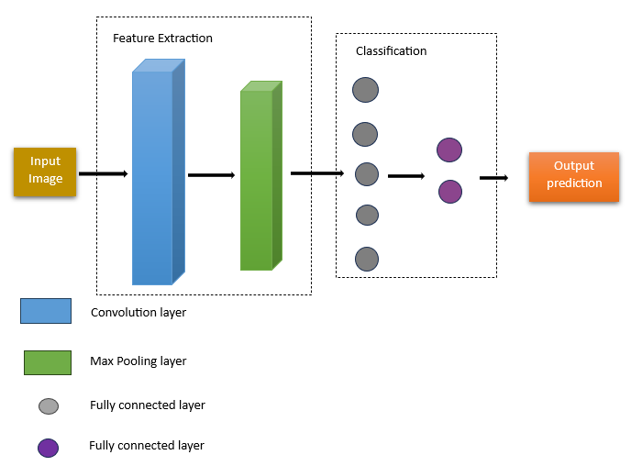
Simple CNN Model

Slide 9
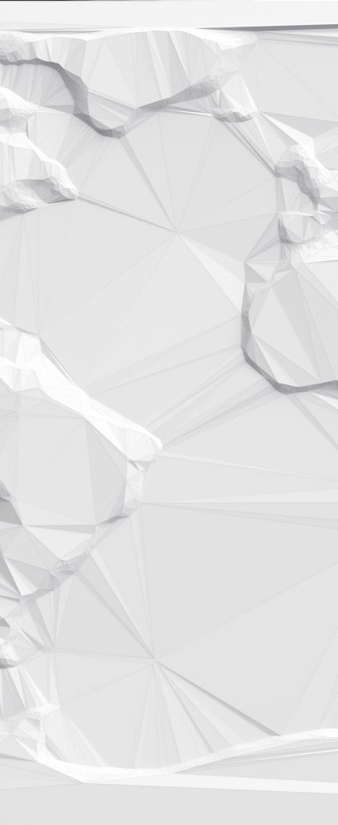
First Layer
Convolutional Layer: The first layer performs convolution on input images. It has 16 filters. Each filter is responsible for detecting specific patterns or features in the image, such as edges, corners, or textures.
Additionally, this convolutional layer is followed by a Rectified Linear Unit (ReLU) activation function, which introduces non-linearity to the network by replacing negative values with zero.
This combination of convolution and activation helps the network learn and extract meaningful features from the input images.

Slide 10
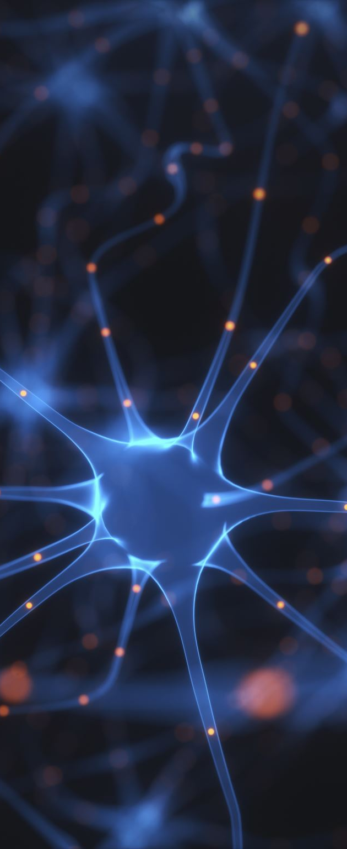
Why are we using activation function in neural network?
An activation function introduces non-linearity into the neural network. Without non-linearity, the neural network would be limited to learning linear relationships between its inputs and outputs, which would severely limit its capacity to model complex data.

Slide 11

Second Layer
Max-Pooling Layer: After convolution, a max-pooling layer is applied. This layer reduces the spatial dimensions of the feature maps by taking the maximum value within a 2x2 window, with a stride of 2. The utilization of a stride helps reduce the spatial size of the feature map. By doing so, it reduces the computational complexity of the neural network, making it more efficient.
So max-pooling helps in reducing computational complexity and retaining important features.

Slide 12
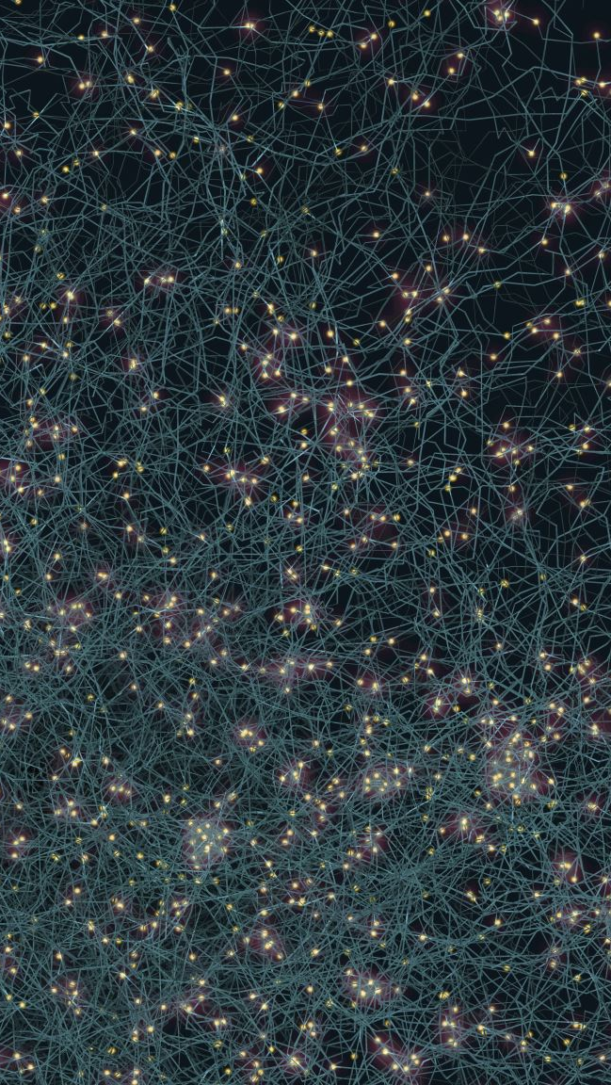
Third layer
First Fully Connected Layer: The next layer is a fully connected layer. It reshapes the flattened feature maps from the previous layers and connects them to 64 neurons. The output of this layer is then passed through a ReLU activation function.

Slide 13
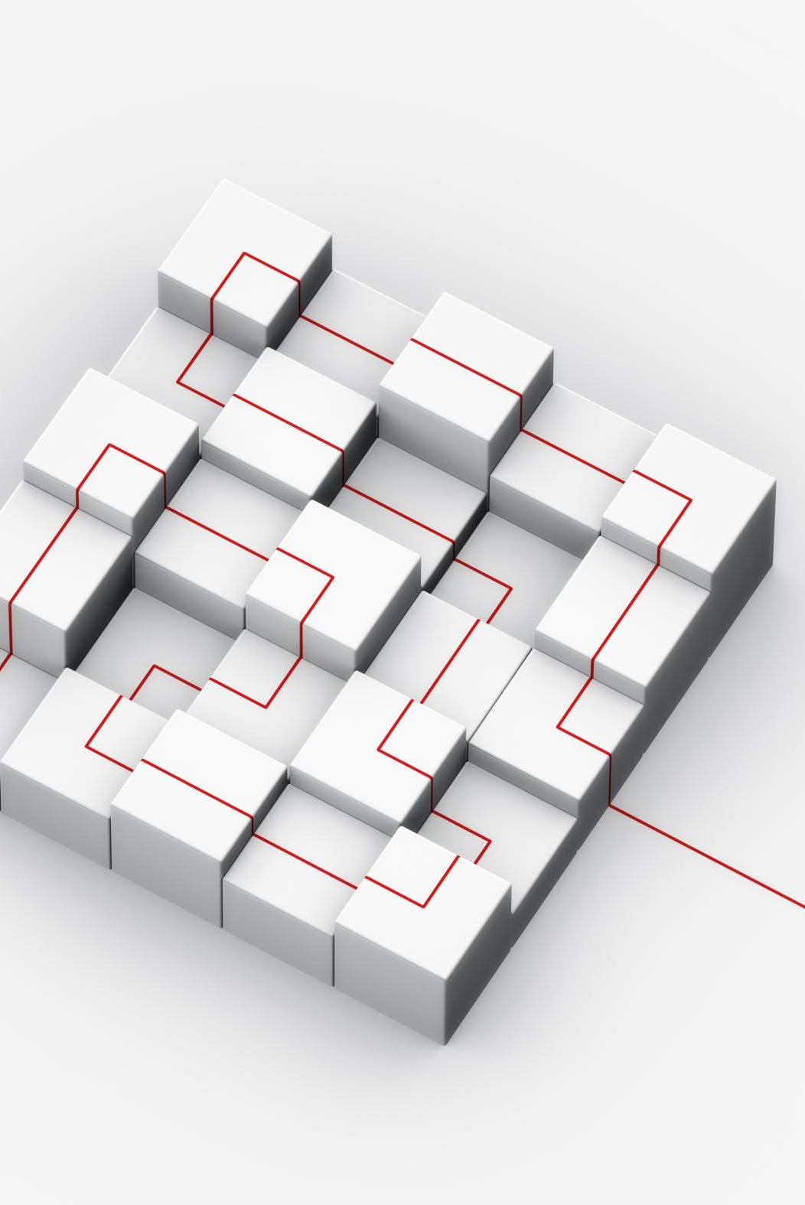
Fourth layer
Second Fully Connected Layer (Output Layer): The final layer is another fully connected layer. It takes the 64-dimensional output from the previous layer and produces the final classification output

Slide 14
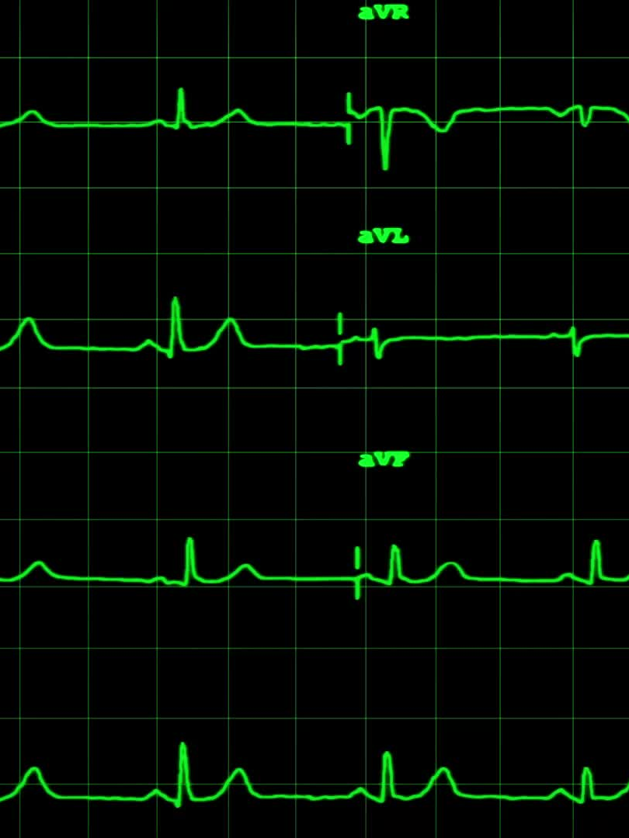
Step 4: Model Training
The model is trained for a specified number of epochs. During each epoch, the model's parameters are updated to minimize the loss, gradually improving its performance on the training data. Here are the following steps:
Calculates the loss function (Why are we using loss function? To minimize the difference between predicted class and actual class) . Here we use cross entropy loss function.
Use RMSprop optimizer for updating the model parameter to improve its performance. (Why are we using optimizer? To adjust the learning rates for model parameter based on their gradients)

Slide 15
Step 4: Model Training
During each epoch, the model's parameters are updated to minimize the loss, gradually improving its performance on the training data.
After processing all batches in an epoch, the average training loss for that epoch is shown.

Slide 16

Step 5: Model Evaluation
It assesses the model's performance on validation data, providing an accuracy metric that quantifies how well the trained model is able to classify images from the validation dataset.
Also, it helps to gauge the model's effectiveness and generalization capabilities.

Slide 17
Step 5: Model Evaluation
The accuracy is defined as follows :
Accuracy = Correct predictions
Total Predictions
Where correct predictions represents the number of correctly classified samples by the model during evaluation.
Where total predictions is the total number of samples in the validation dataset.

Slide 18

Thank You

Slide 19

Any queries?

